Slide 1
Western Michigan University
Covert Timing Channels
Omar Darwish
Instructor: Professor Elise de Doncker

Slide 2
Channels In Networks
Overt channel :
Communication path designed to transmit the information in an authorized way.
Covert channel:
Information is transmitted in unauthorized way.

Slide 3
Covert Channels
Covert channel is an approach for leaking sensitive information across the network, by violating security policies.
The covert channels are of two types:
Covert storage channels.
Depends in memory.
Ex: Data is extra bytes added to ICMP error packets (May tell destination environment such as OS )
Covert timing channels.
Memoryless .
For example transmit secret messages encoded by binary depends on interval packets delay

Slide 4
Covert Timing Channels

Slide 5
Covert Timing Channels
Channels that convey information through the arrival pattern of packets.
Contents of the packets are not used.
Packet1
Packet2
Packet3
Packet4
0
1
0

Slide 6
Application of covert timing channels
Military application
Passing secret messages.
Covert channels detection applied by
USA government .
USA military bodies :National security agency, US Air Force, National Computer Security Center,
Intrusion attacks
Viruses, hacking attacks

Slide 7
Covert Channels between Finite State machines
Suppose there are two finite state machines A and B that are connected via communication channel, such as the Internet.
A and B can exchange information freely without loss.

Slide 8
Cont…
A third finite state machine C is an eavesdropper that knows all information about the finite state machines A and B , their transition functions, states, output functions, etc. In cyberspace.
Finite state machines A and B can be considered as two online applications.

Slide 9
Cont…
C can be an eavesdropper who can capture all information exchanged between A and B.
It is assumed that C knows alphabets, states, and normal transition functions of both machines A and B.
With this setting, there are several areas that A and B can take advantage of to establish covert channels so as to evade C.

Slide 10
A finite state machine (FMS)
is a quintuple where
If bandwidth of the covert channel is high, It means that it easy to detect.

Slide 11
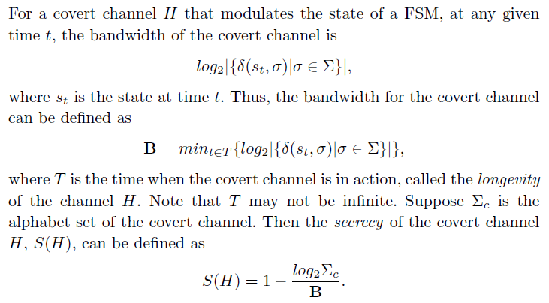
Cont…

Slide 12
Covert timing Channel generation techniques and tools

Slide 13
Generating Covert Timing Channels
Int:erarrival times
2,3,5,15,2, 25, 5,7,19
010
State3
P: 0.9-1.0
20-30
State2
P :0.7-0.9
10-20
State1
P: 0-0.7
0-10

Slide 14
Limitations of end-to-end encryption in secure computer networks by Padlipsky 1976
The first paper introduces generating covert timing channel in 1976.
Sender either send a message or keep silent during particular time.

Slide 15
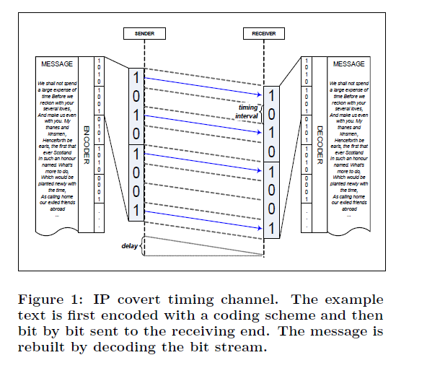
IP Covert Timing Channels: Design Cabuk 2004

Slide 16
Continue…
Additional parity bits appended to the data.
Redundancy for error correction due.
Additional bits may be added for purposes of maintaining synchronization between sender and receiver
Finally, the data may be encrypted in order to add a further layer of privacy

Slide 17
Reducing Fuzzy Covert Timing Channels by Hu 1991
Categorize Timing Channels into :
Software Timing Channels.
Processes communicate by modulating the amount of CPU time they use.
Hardware Timing Channel.
Depends on traffic and bandwidth.
Ex:
To send 1
generates series of instruction with bus traffic (such as referencing memory ).
To send 0
generates series of instruction with no bus traffic.

Slide 18
Cont…
Covert timing channels has an accurate clock.
The interval time representation depends on the current interval times.

Slide 19
Covert timing Channel detection techniques and tools

Slide 20
Detecting covert timing channels based on regularity by Cabuk et al. 2007
Standard deviation based:
Low standard deviation →High regularity& High possibility of covert timing channel.

Slide 21
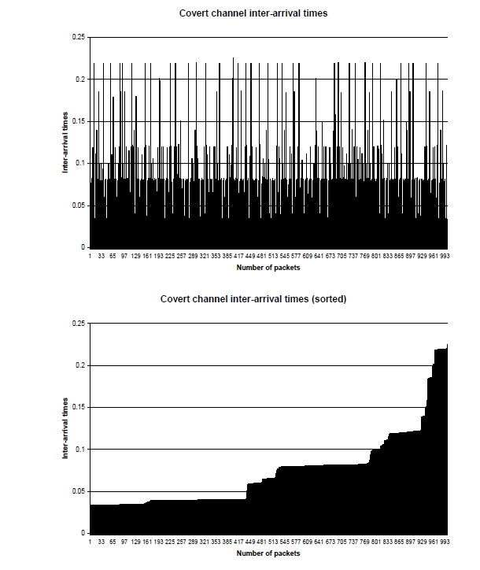
Fundamental regularity

Slide 22
Entropy
Entropy is strongly tied with randomness factor.
The lowest the entropy is, the lowest of randomness in the stream

Slide 23
Examples of entropy
Ex: set of Data : 3,2,5,6,1 (Random)
Entropy = -(1*Log (0.2) )
=0.6
Ex: set of Data : 3,2,3,6,3 (less Random)
Entropy = -(0.6*Log(0.6)+0.4(log0.2)) =0.4

Slide 24
Entropy test score by Steven and Wang 2011
Entropy test score by Steven and Wang
Low entropy → Low randomization & High possibility of covert timing channel.

Slide 25
References
1)Padlipsky,Limitations of end-to-end encryption in secure computer networks.1976
2) Girling, Covert channels in LAN’s, 1987
3) Hu,Reducing Fuzzy Covert Timing Channels, 1991
4) Cabuk, IP Covert Timing Channels: Design, 2004
5) Cabuk, Detecting covert timing channels based on regularity, 2007
6) Steven Gianvecchio, Model-Based Covert Timing Channels, 2008
7) Wu, Detecting IP Covert Timing Channels by Correlating Packet Timing with Memory Content, 2008
8) Liu, Hide and Seek in Time Robust Covert Timing Channels, 2009
9) Steven and Wang, Entropy test score 2011.
10) Wu, Identification and Evaluation of Sharing Memory Covert Timing Channel in Xen Virtual Machines, 2011
11) Yetiana, Constructing The On/Off Covert Channel On Xen, 2012
12) Sangamdace,Automatic Detection Of Illegal Transmission In A Network, 2012
13) Jonathan , Using Covert Timing Channels for Attack Detection in MANETs,2012
14) Daryl Johnson, Behavior-Based Covert Channel in Cyberspace, 2009.

